Slide 1
Constructed response

Slide 2
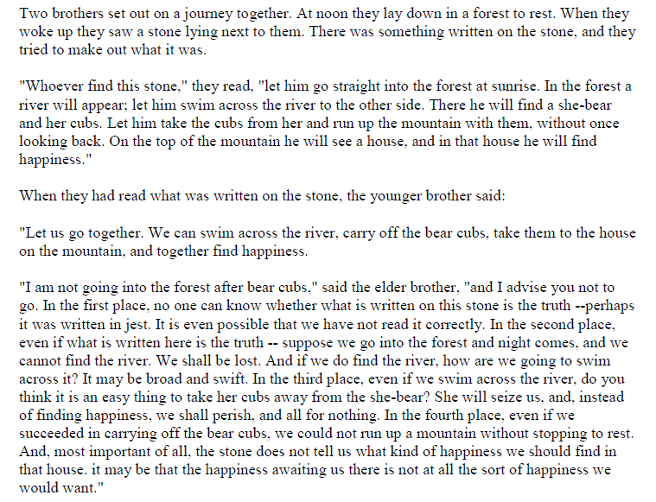
Read the following story and answer the question that follows.

Slide 3
Continued…

Slide 4
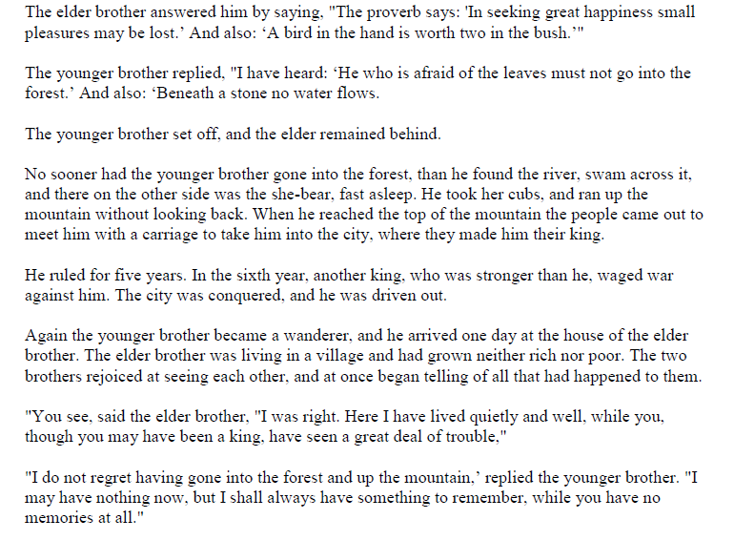
Continued…

Slide 5
Prompt
In your story section, title this constructed response 3/15. Read the short story written by Leo Tolstoy and answer the following question. What is the message of the story and how does the contrast between the two brothers impact the story? Cite textual evidence to back up your points.

